Slide 1
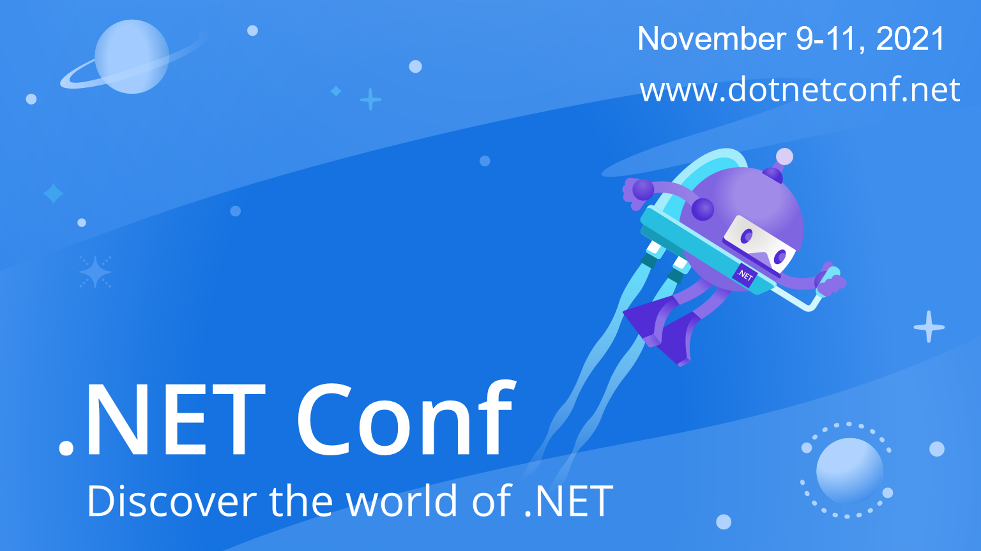

Slide 2


Supercharging your cloud applications with Orleans
Reuben Bond
Notes:
Hi everyone, I’m Reuben Bond and today we’re going to talk about how to supercharge your cloud apps using Microsoft Orleans

Slide 3
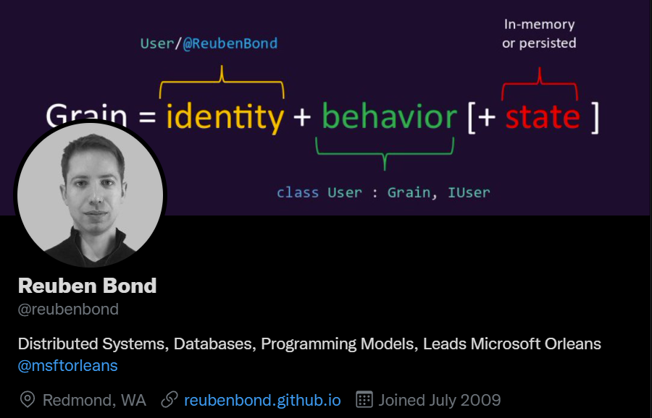
Notes:
Who am I?
I’m a Principal Engineer at Microsoft and I’m the project lead for Orleans.
This is my Twitter, @ReubenBond

Slide 4
Let’s make a Web app

Slide 5
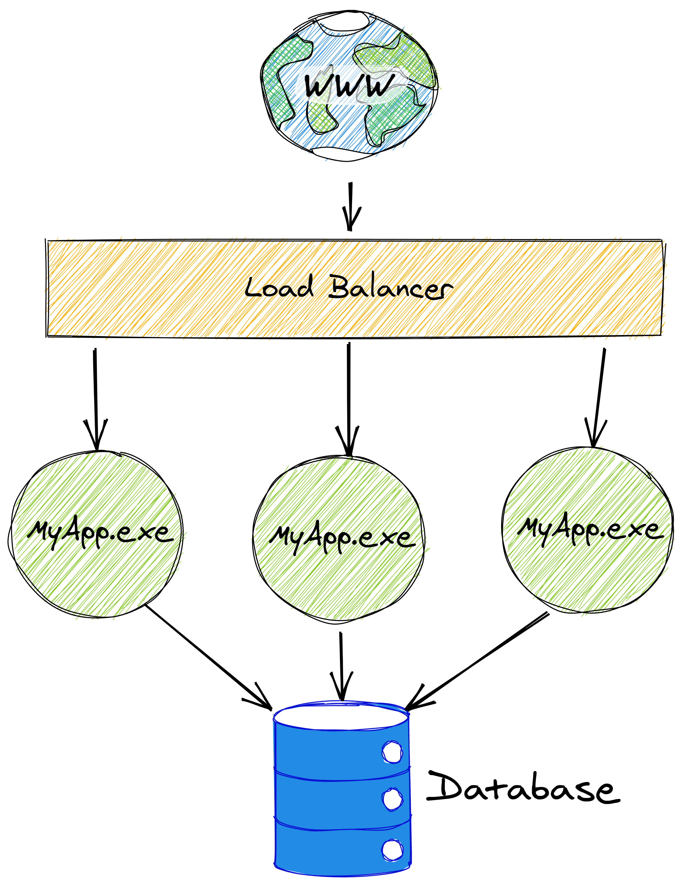
Notes:
Let’s start by saying you’re building a web app
Typical app architecture.
Internet -> LB -> App -> DB
Any time you get a request, it goes through the controller, reads from the database and maybe writes to it.
It’s a popular app, so multiple instances to handle the load as well as for redundancy – we don’t want any downtime.
(NEXT)

Slide 6

Notes:
But we have a problem.
Hitting the DB on every request adds latency.
Those reads can end up putting a lot of load on the database.
What’s more, our writes start hitting contention on the database because we have multiple app instances issuing writes to the same rows.
The database becomes contended and starts slowing down even more as transactions have to wait for one another, or optimistic concurrency writes have to be retried by the app instances when they hit conflicts.

Slide 7
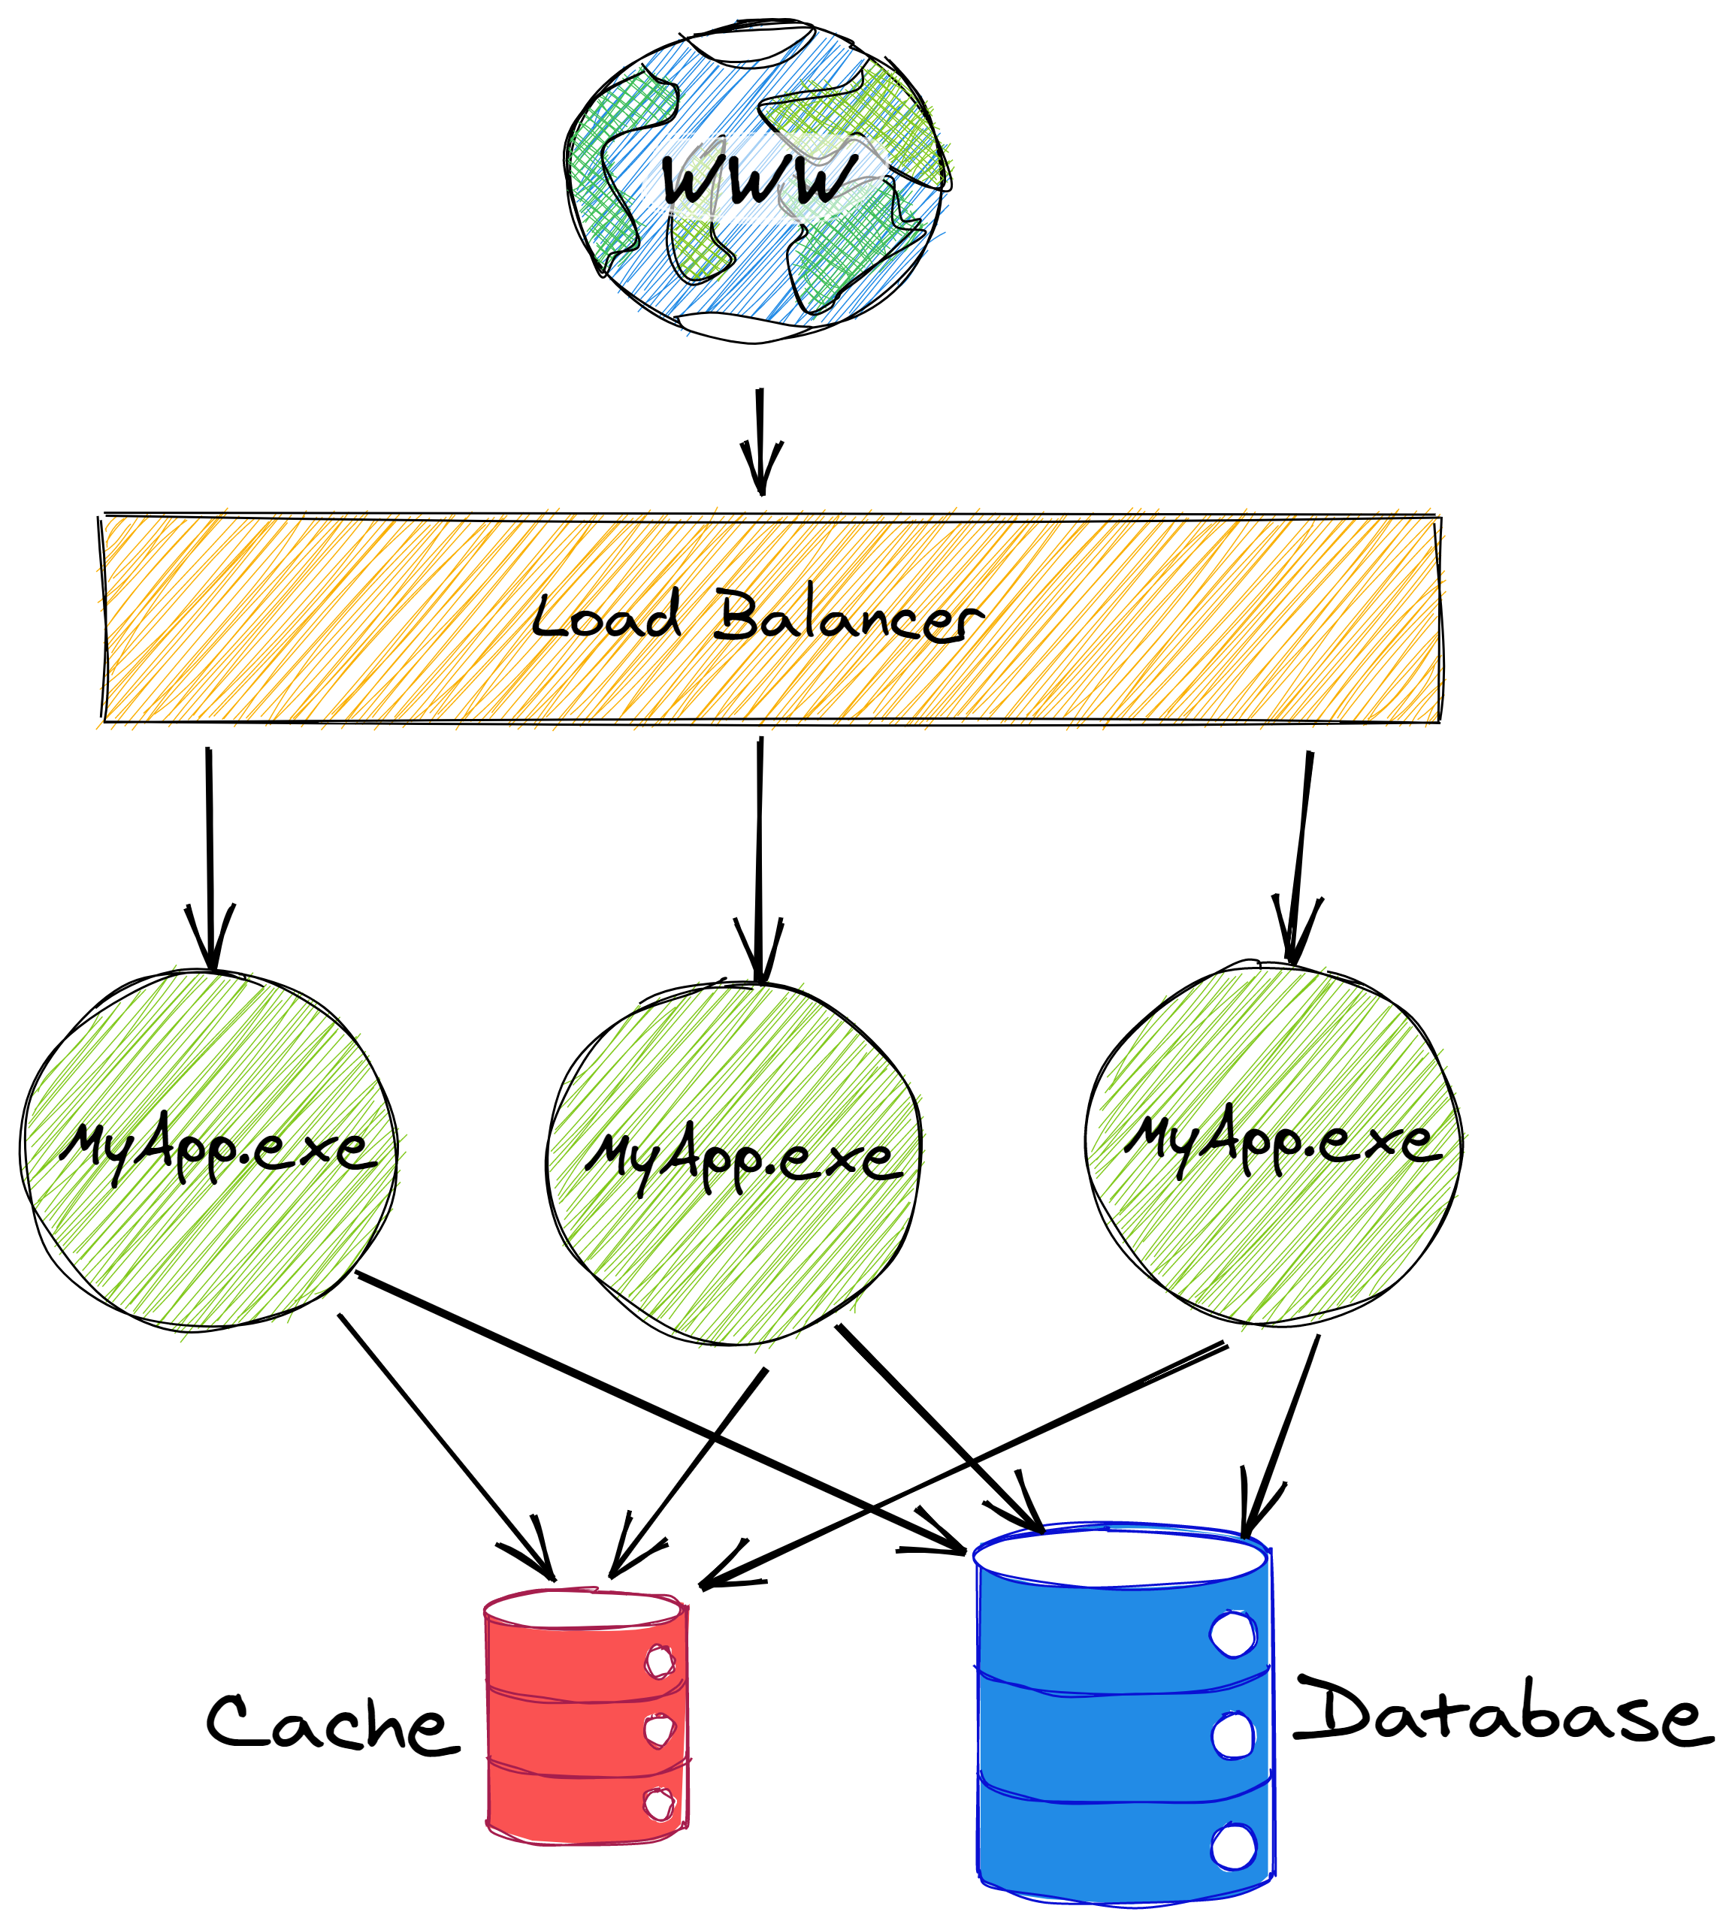
Notes:
Tackle the slow read access by adding a cache. That works for reads, especially for data that doesn’t change much.
When our app wants to update something, it reads from the cache, modifies the value, and writes it back to both the cache and the database.
If the data isn’t in the cache, we read it from the database first.
But there are problems here, too.

Slide 8
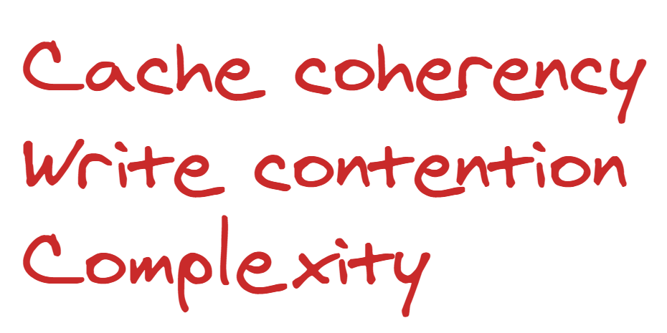
Notes:
There’s a popular saying that there are 2 hard problems in Computer Science:
Naming things,
Cache Invalidation,
Off-by-one errors
Now that we have a shared cache, invalidation is now a problem for us.
So there’s a lot of extra complexity in our app code as well as all of these cache coherency issues.
Also, now we have another dependency which can become inaccessible, so our application can become less reliable as a result.
We still haven’t solved the problem of write contention. So let’s add a queue to try to alleviate that contention.

Slide 9
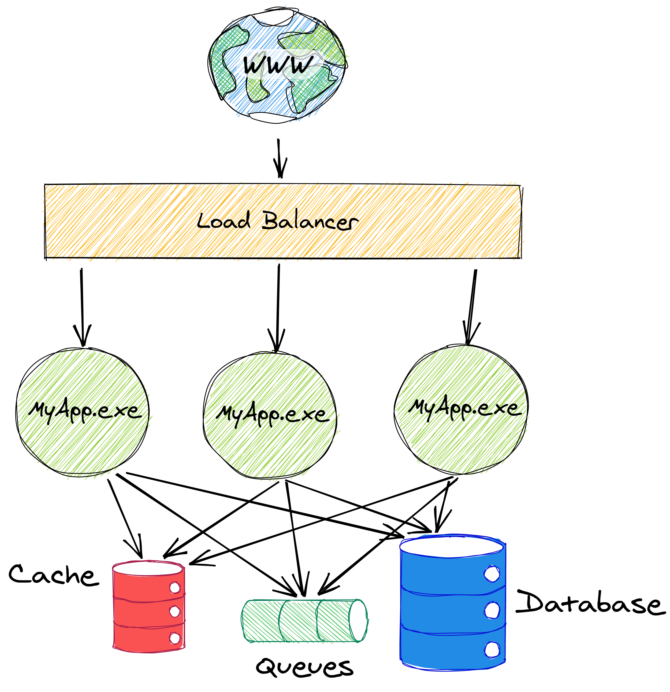
Notes:
Now we have a queue. When we want to update some data, we will put a message in a queue and some worker will be responsible for reading that message and updating both the cache and the database. There are many variants of this approach:
You can use the database or the cache to create a kind of work scheduling system, instead.
The core idea is the same: you put the responsibility of coordinating writes onto something else.

Slide 10
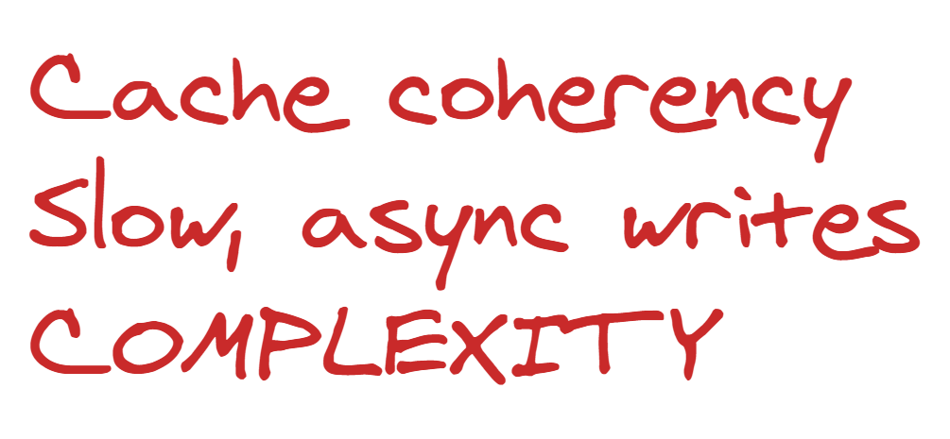
Notes:
This pushes us to make our writes asynchronous, which often involves some kind of polling or background notification.
That can be useful in some cases, but ideally we don’t want to NEED that complexity.
It’s also even slower than just writing directly to the database.
All in all, we have a whole lot of complexity and we still haven’t solved all of our problems. So what’s the solution?

Slide 11
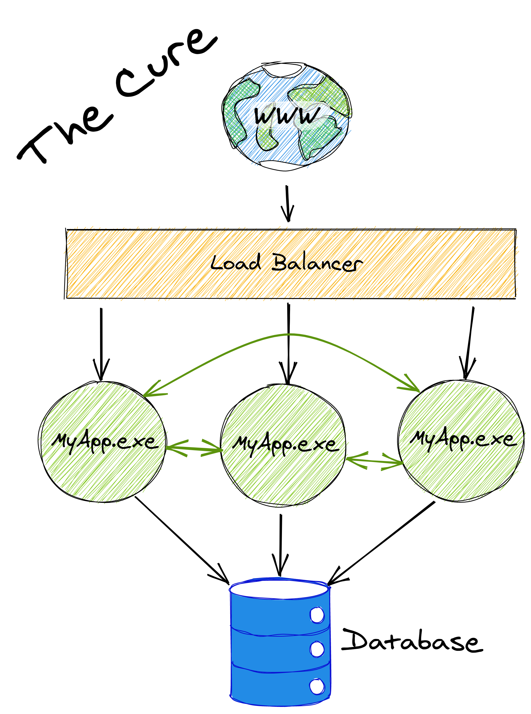
Notes:
What’s the cure. Obviously, this is about Orleans, so Orleans is the cure.
Orleans adds those green arrows in the architecture diagram. It lets your app instances talk to each other.
By doing that, we can we can very efficiently cache data and coordinate writes.
We don’t have cache coherency issues, or write contention, or crazy dependencies or complicated code with retry logic everywhere.
Everything is fast, easy to understand and code for, and reliable. And it scales up or out as far as you need.

Slide 12
Microsoft Orleans
Framework for building stateful cloud-based apps with .NET
Core building block: Grains – cloud native objects
Communicate with grains using interface calls (RPC)
Orleans runtime handles scale out/in, fault tolerance, service discovery, load balancing, messaging, routing
Running in production at MS for over 9 years, adopted by many product groups & external users
Eg: Azure Digital Twins, Halo, Microsoft Mesh, Dynamics 365 Fraud Protection, Azure ML, Azure Quantum, Azure PlayFab

Slide 13
Grains
Core building block (akin to ASP.NET Controller or SignalR Hub)
Divide our app up into many little objects (Grains)
One for each user profile, shopping cart, game session, chat room, blog post, compute job, etc
Each one gets an id, a class, and can persist its state
Orleans distributes them among your servers
Orleans loads them into memory as needed and unloads them when they’ve become idle
Orleans routes calls to the right grain instance
Every IUserProfileGrain.Get() call for “user/sbykov” is routed to the same object
Grains are single-threaded by default
Less bugs, no locks, easier to coordinate writes to storage

Slide 14
Voting App
A web app which lets users create and vote on polls consisting of a question and a series of options

Slide 15
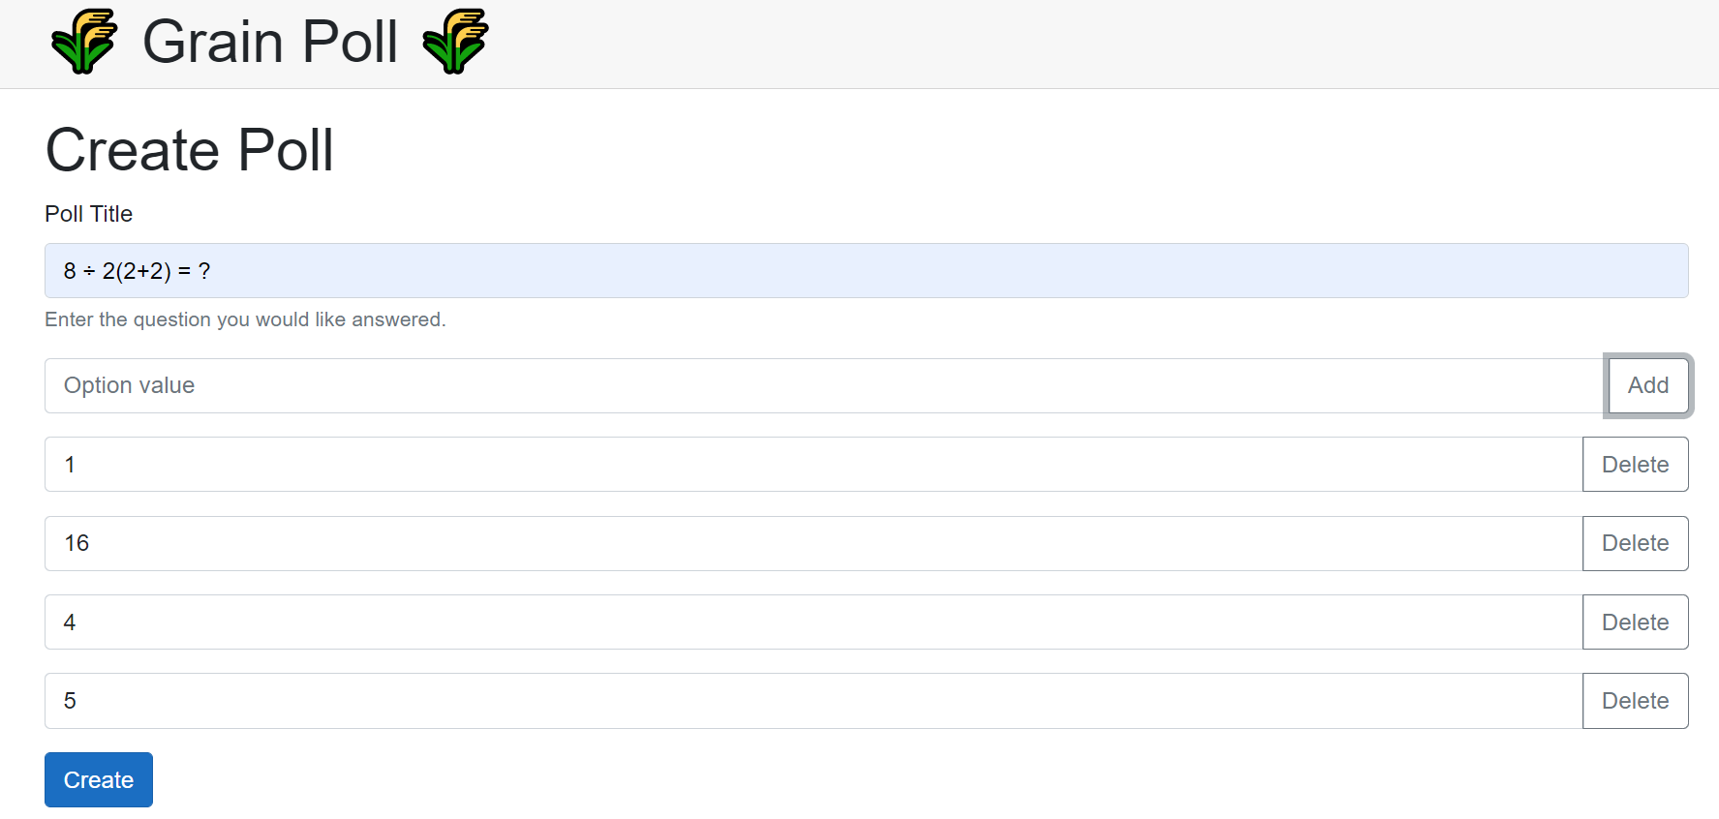

Slide 16
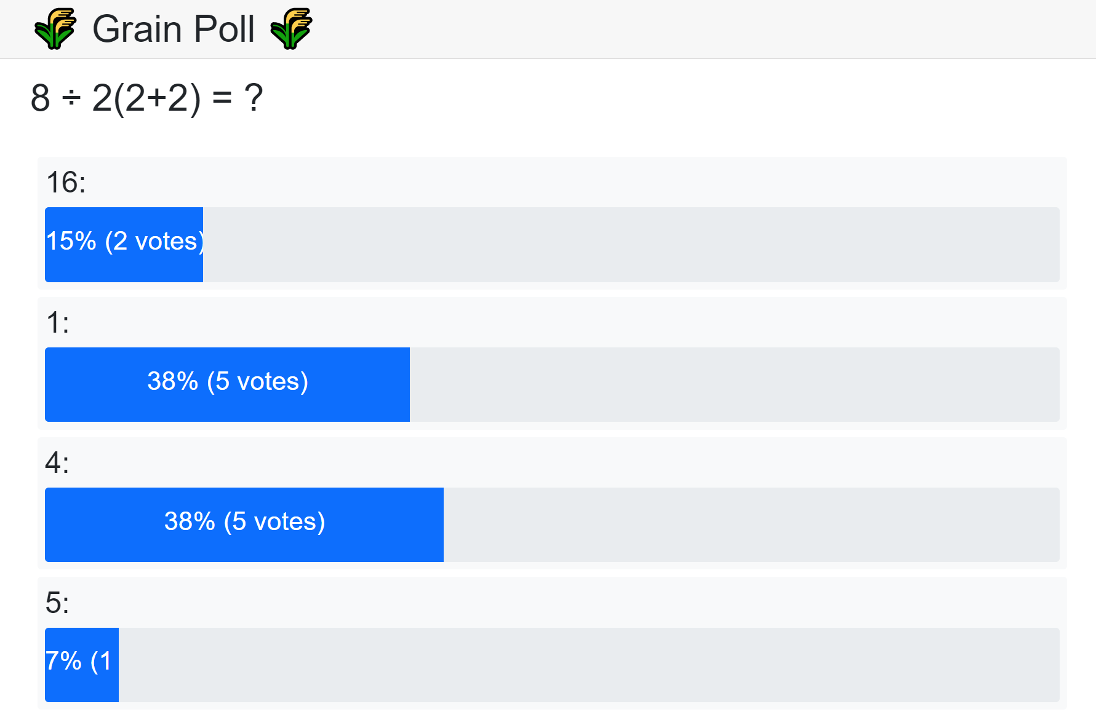

Slide 17
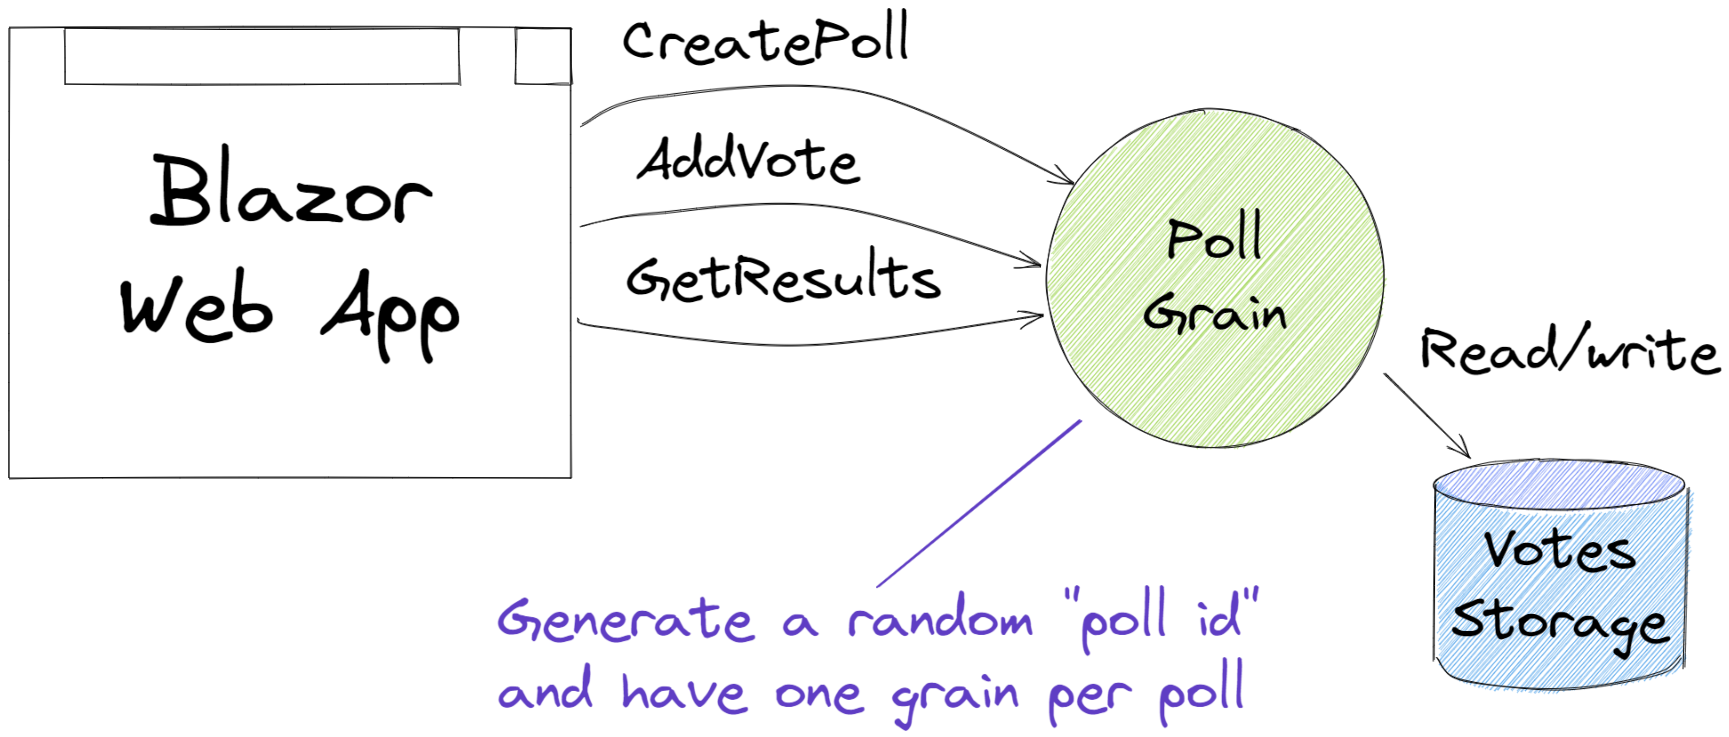
Notes:
So how do we design this using Orleans?
Here’s an idea. What if we have a “poll grain” which holds the poll definition and the vote data.
So we’ll generate a random id in our Blazor Web App and use that as the poll grain’s id.
The grain can keep all its state in storage and has methods for create, read, and update.
This will work, but if we’re going to put this on the internet there’s a problem.
People won’t restrict themselves to voting in a poll once just because you ask nicely.
People may also try to generate millions of polls and flood your service, or they might just issue many requests to a single poll.
How do we prevent that?

Slide 18
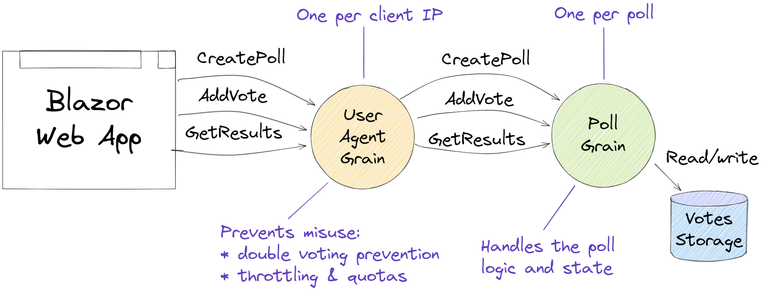
Notes:
Here’s one way. I’ve added a new grain into the mix. We still have the Blazor Web App on the left and we have the poll grain on the right.
But now we also have a “User Agent Grain” in the middle. We’ll use the Client’s IP address as the id for this grain, so that will give us one per user.
The job of the User Agent is to act on behalf of the user and so it has the same methods on it as the poll grain but it does something extra: it helps to prevent misuse.
It does this by remembering
* how many polls a user has created
* which polls a user has voted in
* how many requests a user has made recently
That way, it can prevent users from flooding the system with polls.
It can prevent double voting.
And it can throttle users who are trying to flood the system with requests.

Slide 19
Demo – Voting App
A web app which lets users create and vote on polls consisting of a question and a series of options
Notes:
How can Orleans help us build this?
How do we prevent misuse?
How do we make it update in real-time?

Slide 20
Features
Persistence
Plugins for Azure Storage, Cosmos DB, SQL, DynamoDB, Redis, MongoDB, …
Distributed ACID transactions
Read/write state in multiple grains transactionally
Virtual streams
Decouple producers & consumers. Backed by Azure Event Hubs, Amazon SQS, GCP, in-memory
Timers & reminders
Ephemeral timers, persistent reminders for scheduling future event
Observers
Grains can send events (RPC calls) directly to clients. Eg, push notifications, streams
Transport layer security
Mutual TLS between clients and the cluster as well as nodes within the cluster
Deployment freedom
Kubernetes, Azure App Service, Azure Container Apps, VMs, on-premises, Windows, Linux, macOS
Custom placement & directory
Customize how the runtime decides where new grains are instantiated & how it finds them. “Move computation to data”
Call filters
Wrap incoming & outgoing requests & responses for logging, tracing, error handling
.NET
DI/Logging/Hosting/Configuration
Networking built on Project Bedrock
Notes:
~3 mins
Alright, last slide about the framework, and I just wanted to highlight a few of the features here
# Persistence
Nice and simple, .NET objects and method calls. Can change backends easily.
Fine to avoid.
# Transactions
Very cool! Unique!
Transactional State
Transfer Method
Transactions can really simplify your life because there are a lot of error cases that you don’t need to consider when using transactions.
7:30
# Virtual Streams
RPC is a great
Decouple both sides of the communication, decouple temporally -> Orleans Streams! Pluggable
Declarative bindings
# Deployment freedom
Orleans is unopinionated about where it runs. You can add Orleans to the .NET Generic Host Builder, so it works just about everywhere. Internally, teams are running Orleans on Linux, Windows, AKS, Service Fabric, Azure Cloud Services, or bare VMs.

Slide 21
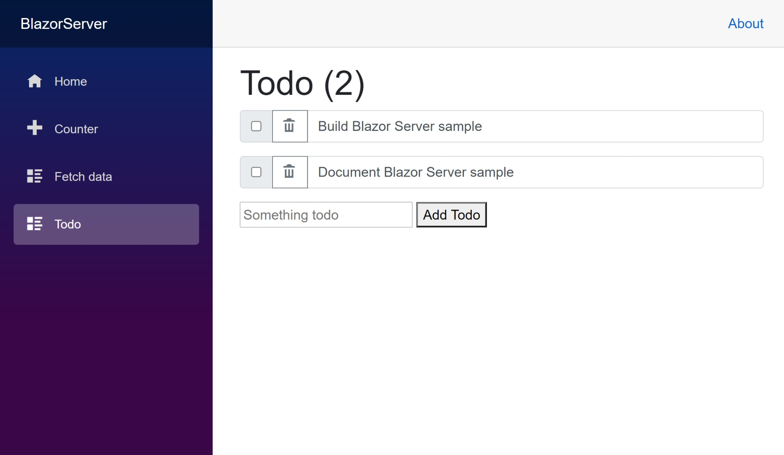
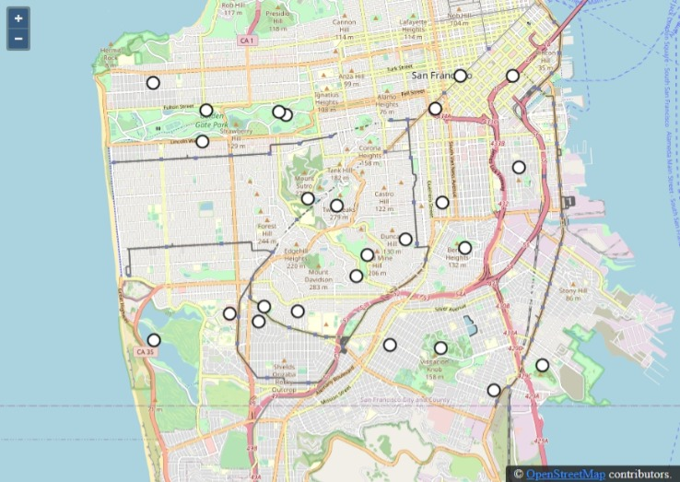
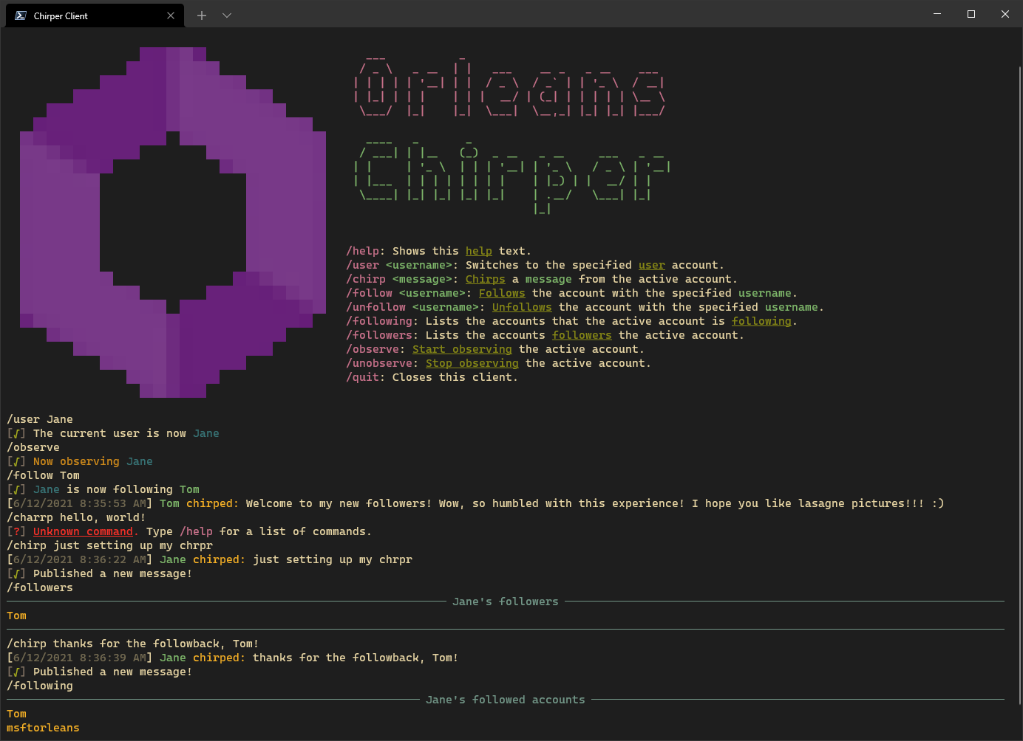
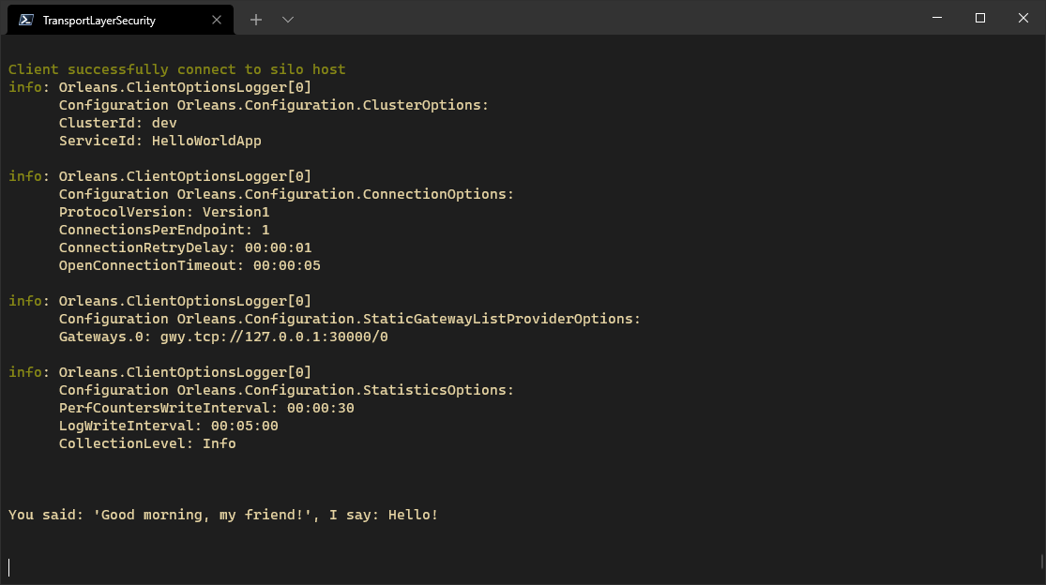
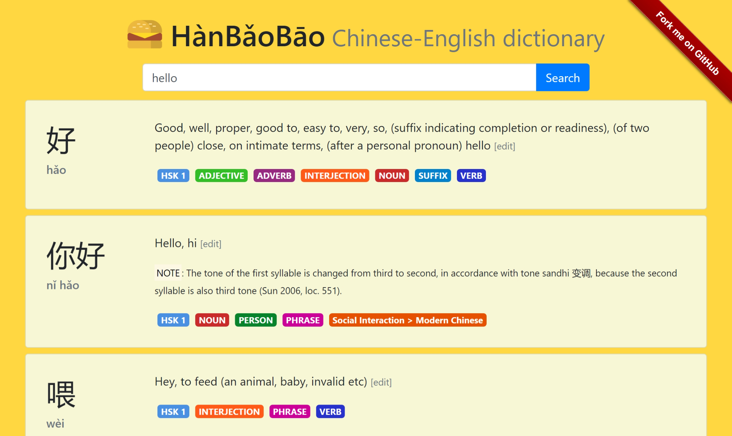
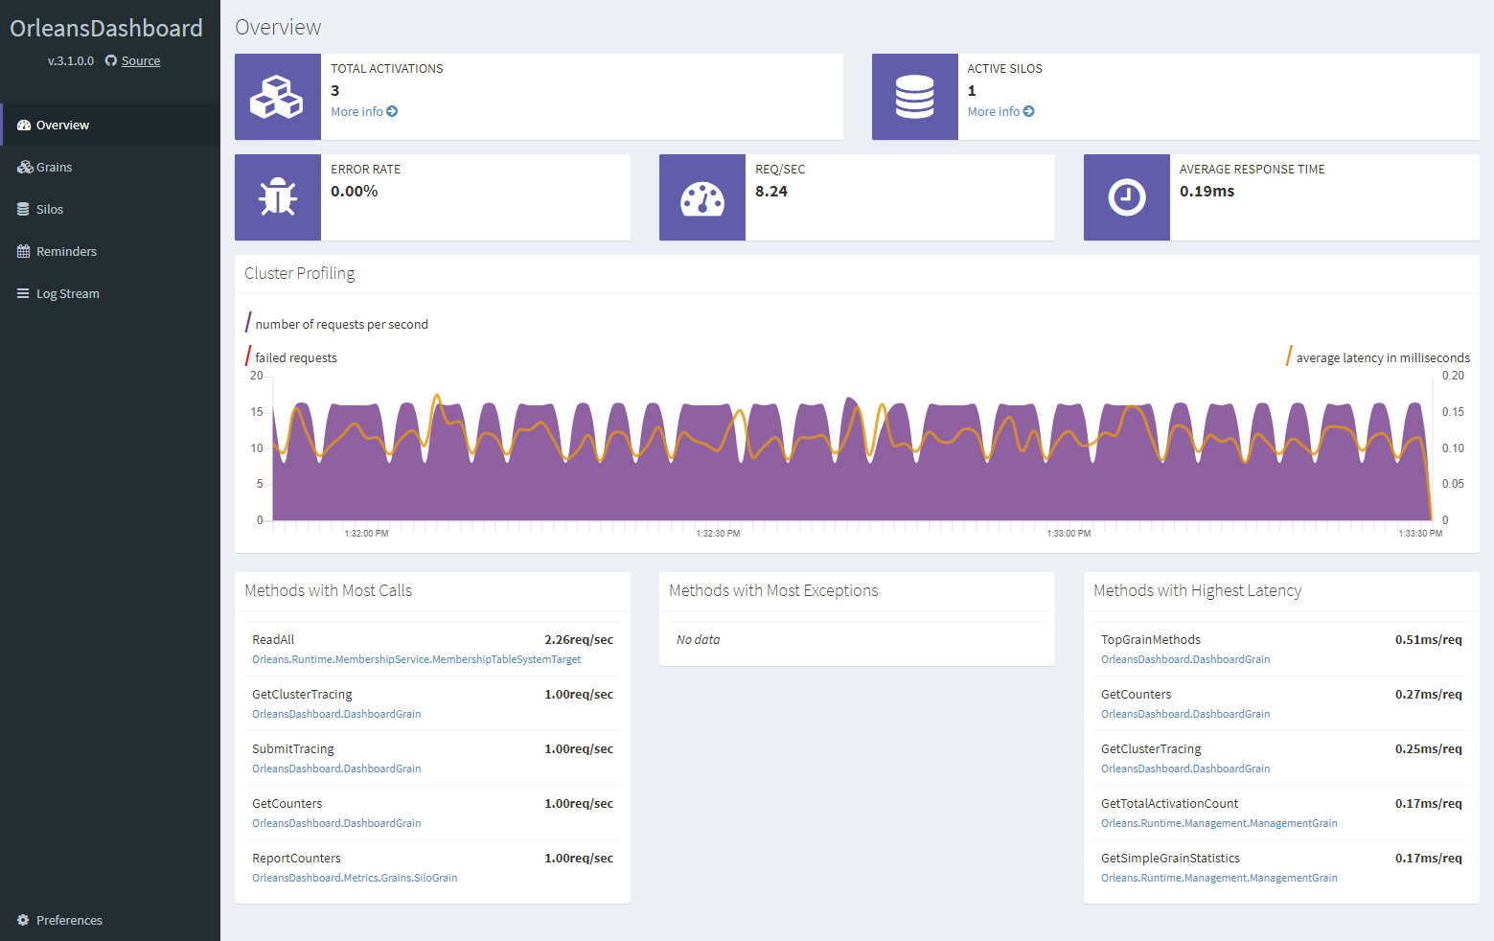
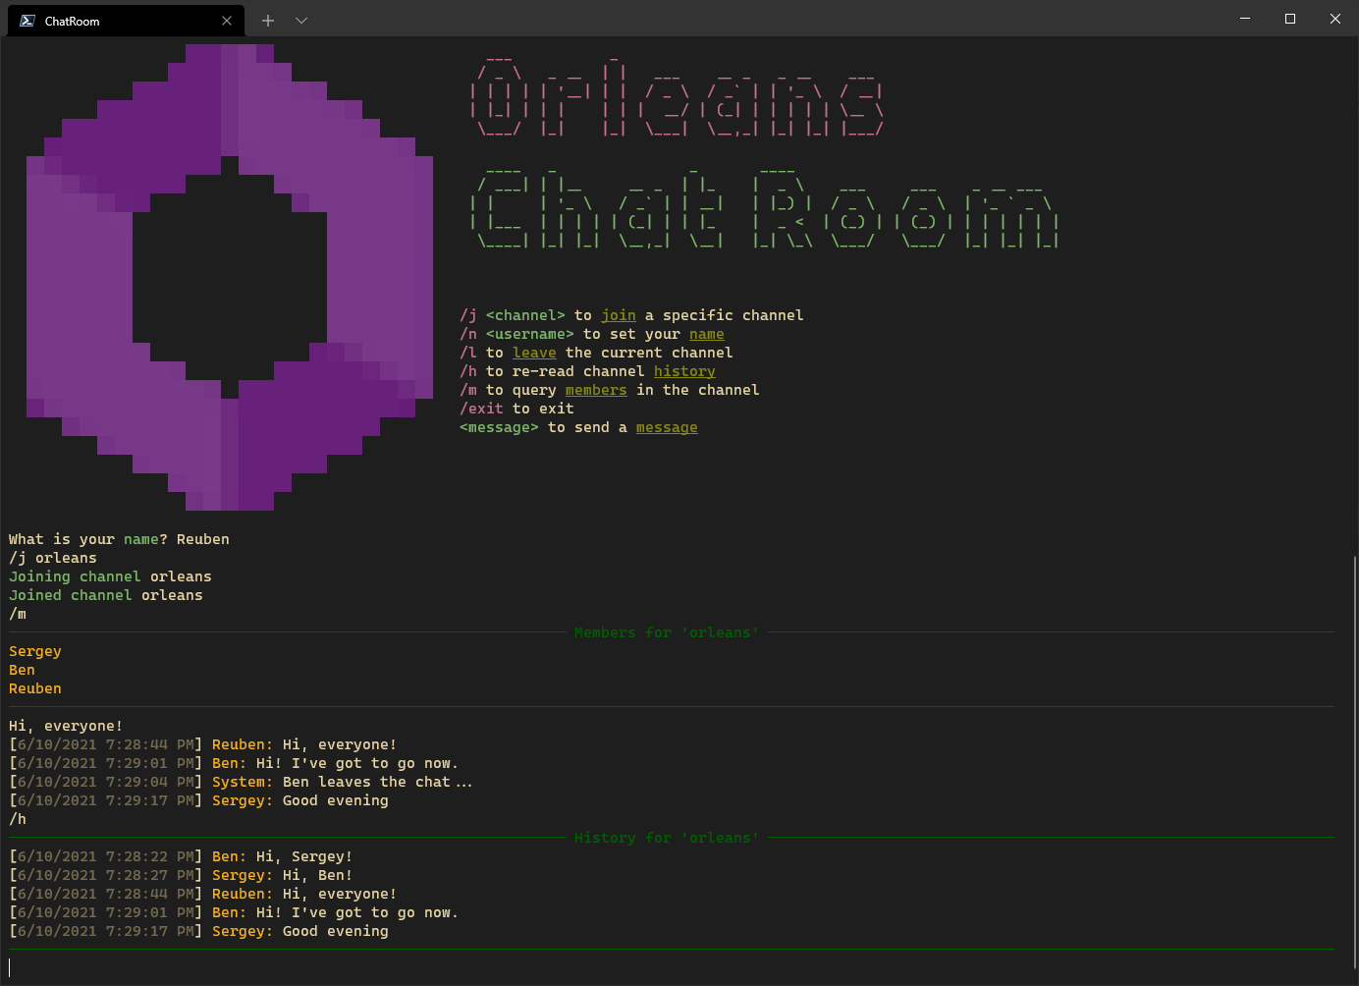
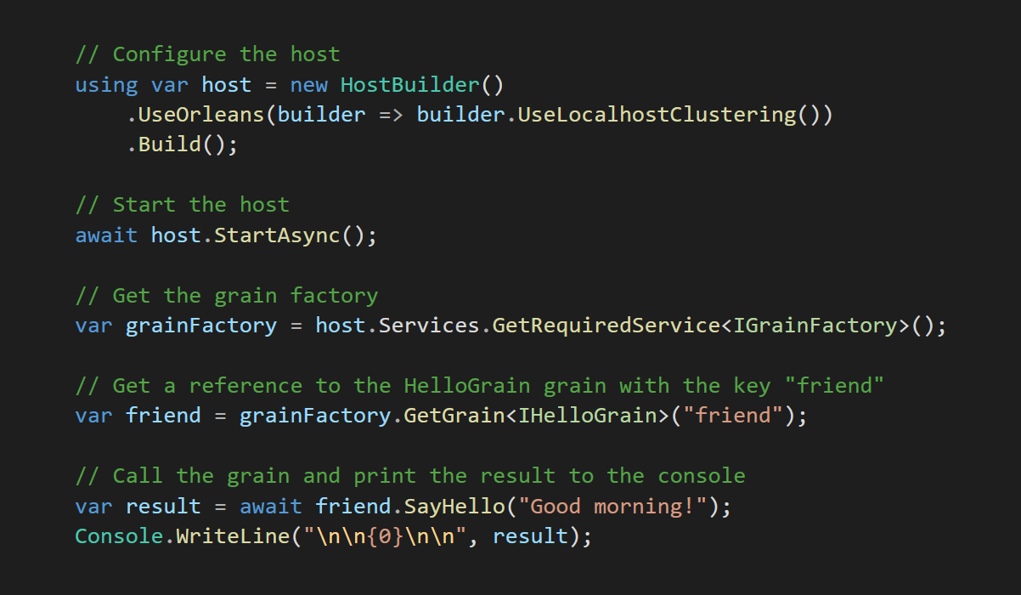
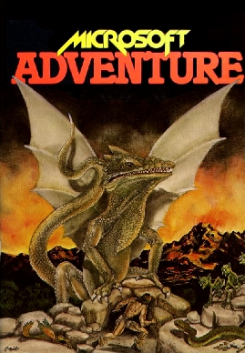
https://aka.ms/orleans-samples

Slide 22
Thanks for joining!
Gitter: https://gitter.im/dotnet/orleans
Discord: https://aka.ms/orleans-discord
GitHub: https://github.com/dotnet/orleans
@ReubenBond
@msftorleans

Slide 23
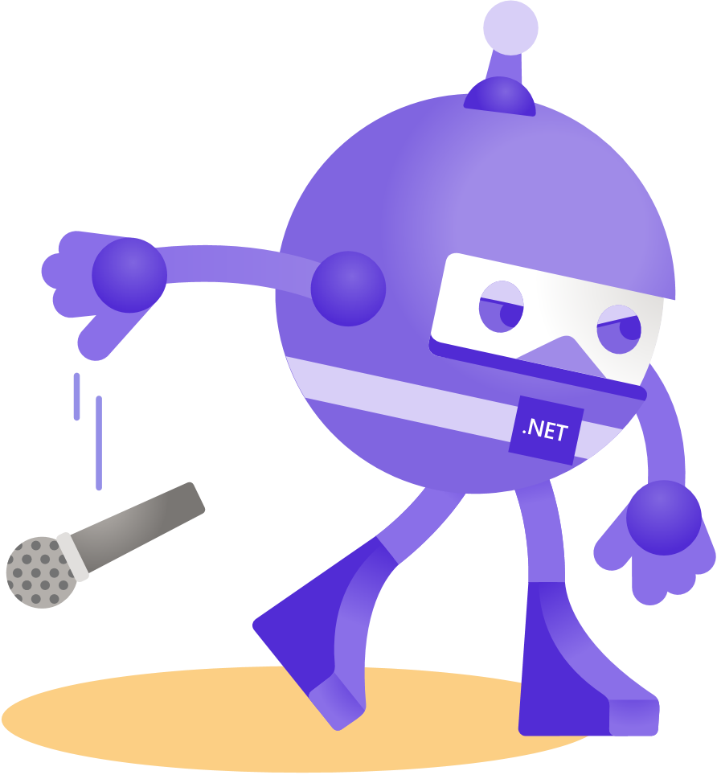
Thanks for joining!

